Slide 1
Lecture 9 – Natural Language Processing
AY 2024-25

Slide 2
Lesson Outline
L9 – Natural Language Processing
NLP: An Introduction
Text Preprocessing
Feature Engineering on Text
Major NLP Tasks

Slide 3
1. NLP: An Introduction
What is NLP?
NLP and Text Analytics
What Does NLP Do?

Slide 4
What is NLP?
Natural Language Processing (NLP) is the application of computational techniques to the analysis and synthesis of natural language and speech.
Text analytics (also referred to as text mining) is an artificial intelligence (AI) technology that uses natural language processing (NLP) to transform the free (unstructured) text in documents and databases into normalized, structured data suitable for analysis.
Text mining is a process of exploring sizeable textual data and find patterns.

Slide 5
NLP and Text Analytics
To put it simply, text analytics deals with the text itself, while NLP deals with the underlying metadata.
For a sentence, “A major incarnation of the weather phenomenon known as El Nîno is gathering force in the Pacific Ocean.”
Answering questions like - frequency counts of words, length of the sentence, presence/absence of certain words etc. is text analytics.

Slide 6
NLP and Text Analytics
NLP on the other hand allows you to answer questions like:
What is the sentiment?
What are the keywords? (using POS tagging & parsers)
What category of content it falls under?
Which are the entities in the sentence? And more
NLP in most cases needs a good understanding of statistics and Machine Learning.

Slide 7
What Does NLP Do?
NLP is a branch of artificial intelligence that consists of systematic processes for analyzing, understanding, and deriving information from the text data in a smart and efficient manner.
By utilizing NLP and its components, one can organize the massive chunks of text data, perform numerous automated tasks and solve a wide range of problems such as – automatic summarization, machine translation, named entity recognition, relationship extraction, sentiment analysis, speech recognition, etc.

Slide 8
NLTK (1)
NLTK stands for Natural Language Toolkit. It is a popular open-source library for natural language processing (NLP) in Python.
NLTK provides a wide range of tools and resources for tasks such as tokenization, stemming, tagging, parsing, semantic reasoning, and wrappers for industrial-strength NLP libraries.

Slide 9
NLTK (2)
Text Processing: NLTK offers various text processing capabilities, including tokenization (splitting text into words or sentences), stemming (reducing words to their base or root form), and lemmatization (reducing words to their dictionary form).
Part-of-Speech Tagging: NLTK provides pre-trained models and algorithms for part-of-speech (POS) tagging, which assigns grammatical tags to words in a sentence, such as noun, verb, adjective, etc.
Named Entity Recognition: NLTK includes tools for named entity recognition (NER), which identifies and extracts named entities like names, locations, organizations, and dates from text.

Slide 10
NLTK (3)
Parsing and Chunking: NLTK supports syntactic parsing and chunking, allowing you to analyze the grammatical structure of sentences and extract meaningful phrases or chunks.
Corpora and Lexical Resources: NLTK includes a wide range of corpora (large collections of text) and lexical resources, such as WordNet (a lexical database) and various language-specific datasets, which can be used for language analysis and experimentation.
Text Classification: NLTK offers functionalities for text classification tasks, allowing you to build and train classifiers for tasks like sentiment analysis, spam detection, topic categorization, and more.

Slide 11
2. Text Preprocessing
An Overview
Noise Removal
Lexicon Normalization
Object Standardization

Slide 12
An Overview
Since, text is the most unstructured form of all the available data, various types of noise are present in it and the data is not readily analyzable without any pre-processing.
The entire process of cleaning and standardization of text, making it noise-free and ready for analysis is known as text preprocessing.
It is predominantly comprised of three steps:
Noise Removal
Lexicon Normalization
Object Standardization.

Slide 13
Noise Removal
Any piece of text which is not relevant to the context of the data and the end-output can be specified as the noise.
For example – language stopwords (commonly used words of a language – is, am, the, of, in, etc.), URLs or links, punctuations and industry specific words.
This step deals with removal of all types of noisy entities present in the text.

Slide 14
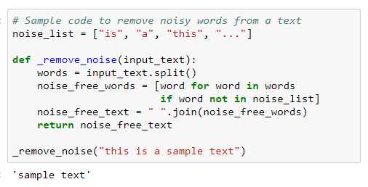
Noise Removal (2)
A general approach for noise removal is to prepare a dictionary of noisy entities, and iterate the text object by tokens (or by words), eliminating those tokens which are present in the noise dictionary.
Following is the python code for the same purpose.

Slide 15
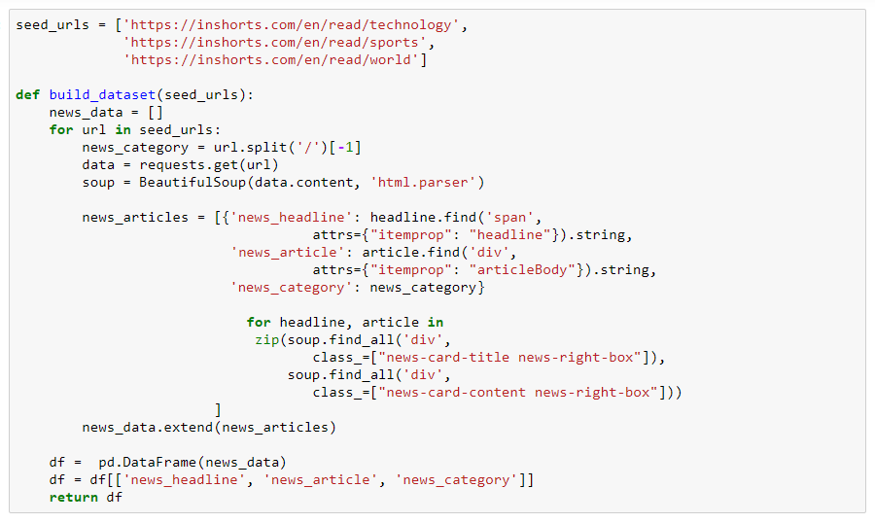
Noise Removal (3)
NLP_Tasks.ipynb
Load Live Data

Slide 16
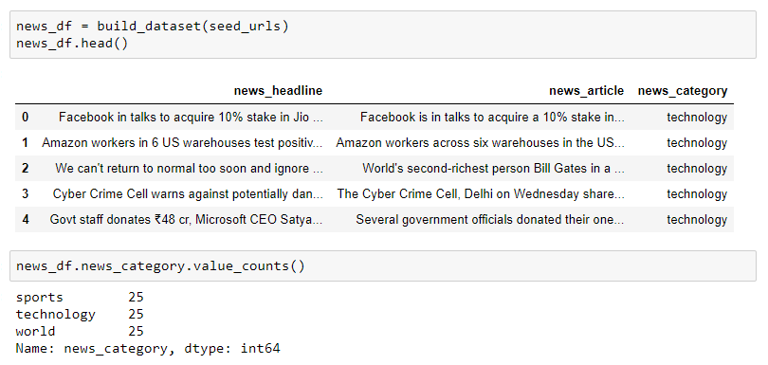
Noise Removal (4)
Explore Data

Slide 17
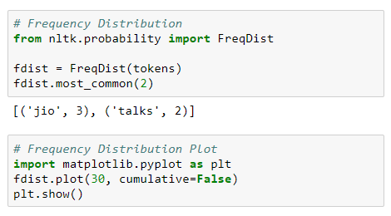
Noise Removal (5)
Explore Data

Slide 18
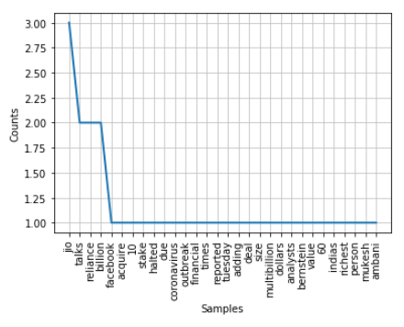
Noise Removal (6)
Explore Data

Slide 19
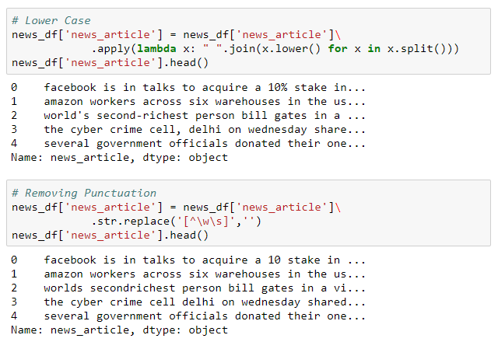
Noise Removal (7)

Slide 20
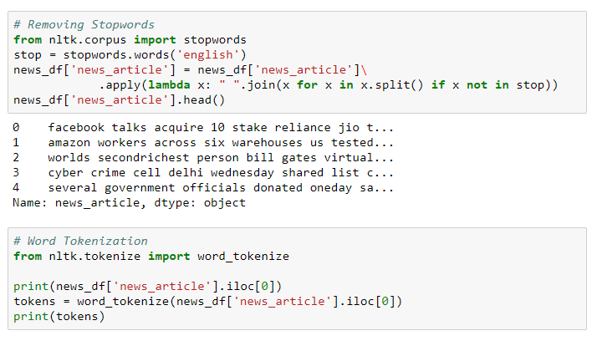
Noise Removal (8)

Slide 21
Lexicon Normalization
Another type of textual noise is about the multiple representations exhibited by single word.
For example – “play”, “player”, “played”, “plays” and “playing” are the different variations of the word – “play”.
Though they mean different but contextually all are similar.
The step converts all the disparities of a word into their normalized form (also known as lemma).

Slide 22
Lexicon Normalization (2)
Normalization is a pivotal step for feature engineering with text as it converts the high dimensional features (N different features) to the low dimensional space (1 feature), which is an ideal ask for any ML model.
The most common lexicon normalization practices are :
Stemming: Stemming is a rudimentary rule-based process of stripping the suffixes (“ing”, “ly”, “es”, “s”, etc.) from a word.

Slide 23
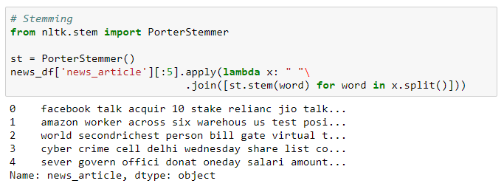
Lexicon Normalization (3)

Slide 24
Lexicon Normalization (4)
Lemmatization: Lemmatization, on the other hand, is an organized & step by step procedure of obtaining the root form of the word, it makes use of vocabulary (dictionary importance of words) and morphological analysis (word structure and grammar relations).

Slide 25
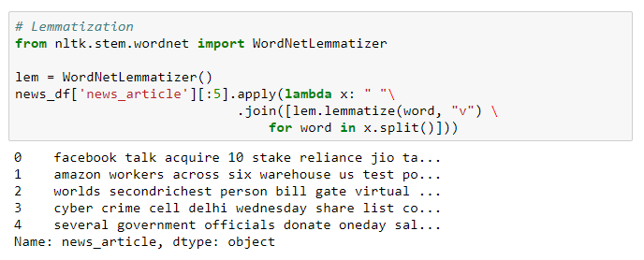
Lexicon Normalization (5)

Slide 26
Object Standardization
Text data often contains words or phrases which are not present in any standard lexical dictionaries.
These pieces are not recognized by search engines and models.
Some of the examples are – acronyms, hashtags with attached words, and colloquial slangs.
With the help of regular expressions and manually prepared data dictionaries, this type of noise can be fixed, the code below uses a dictionary lookup method to replace social media slangs from a text.

Slide 27
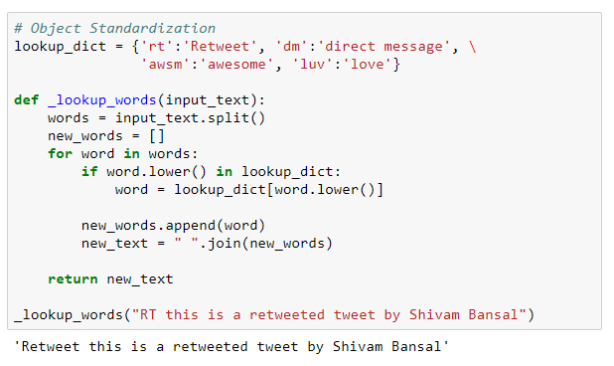
Object Standardization (2)

Slide 28
3. Feature Engineering on Text
Overview
Part of Speech (POS) Tagging
N-Grams as Features
Statistical Features

Slide 29
Overview
To analyze a preprocessed data, it needs to be converted into features.
Depending upon the usage, text features can be constructed using assorted techniques – Syntactical Parsing, Entities / N-grams / word-based features, Statistical features, and word embeddings.
Read on to understand these techniques in detail.

Slide 30
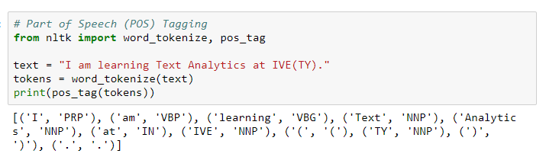
Part of Speech Tagging
Apart from the grammar relations, every word in a sentence is also associated with a part of speech (POS) tag (nouns, verbs, adjectives, adverbs, etc.).
The POS tags defines the usage and function of a word in the sentence.

Slide 31
N-Grams as Features
A combination of N words together are called N-Grams.
N grams (N > 1) are generally more informative as compared to words (unigrams) as features.
Also, bigrams (N = 2) are considered as the most important features of all the others.
The following code generates trigram of a text.

Slide 32
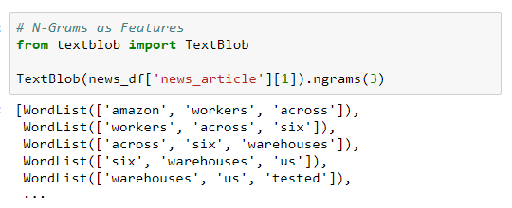
N-Grams as Features (2)

Slide 33
Statistical Features
Text data can also be quantified directly into numbers using several techniques.
Term Frequency – Inverse Document Frequency (TF-IDF) is a weighted model commonly used for information retrieval problems.
It aims to convert the text documents into vector models on the basis of occurrence of words in the documents without taking considering the exact ordering.

Slide 34
Statistical Features (2)
For Example – let say there is a dataset of N text documents, In any document “D”, TF and IDF will be defined as:
Term Frequency (TF) – TF for a term “t” is defined as the count of a term “t” in a document “D”
Inverse Document Frequency (IDF) – IDF for a term is defined as logarithm of ratio of total documents available in the corpus and number of documents containing the term T.

Slide 35
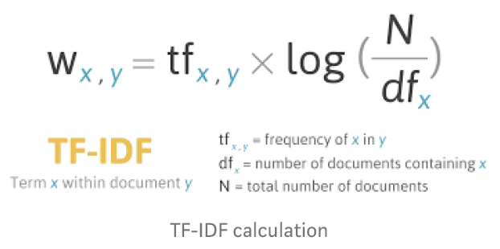
Statistical Features (3)

Slide 36
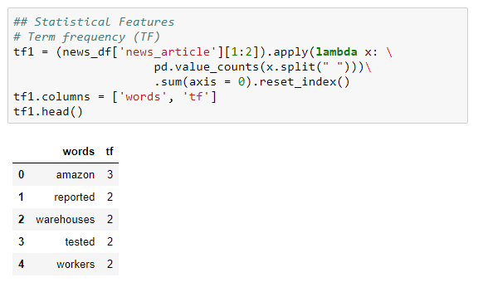
Statistical Features (4)

Slide 37
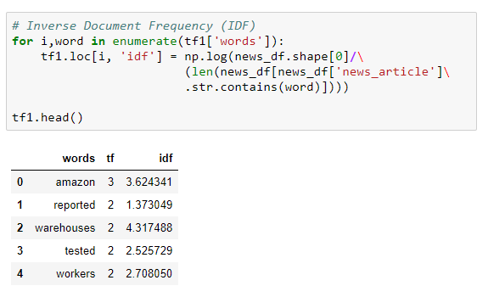
Statistical Features (5)

Slide 38
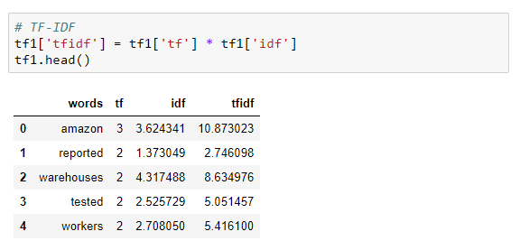
Statistical Features (6)

Slide 39
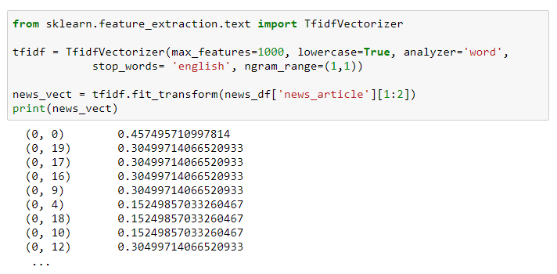
Statistical Features (7)

Slide 40
4. Major NLP Tasks
Sentiment Analysis
Text Classification

Slide 41
Sentiment Analysis
Sentiment analysis (also known as opinion mining) refers to the use of NLP, text analysis, computational linguistics, and biometrics to systematically identify, extract, quantify, and study affective states and subjective information.
Sentiment analysis is widely applied to voice of the customer materials such as reviews and survey responses, online and social media, and healthcare materials for applications that range from marketing to customer service to clinical medicine.

Slide 42
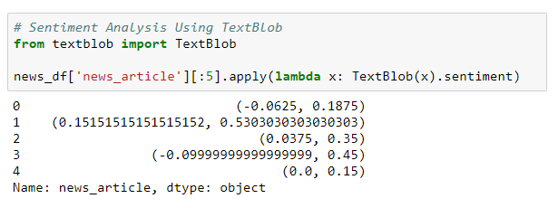
Sentiment Analysis (2)

Slide 43
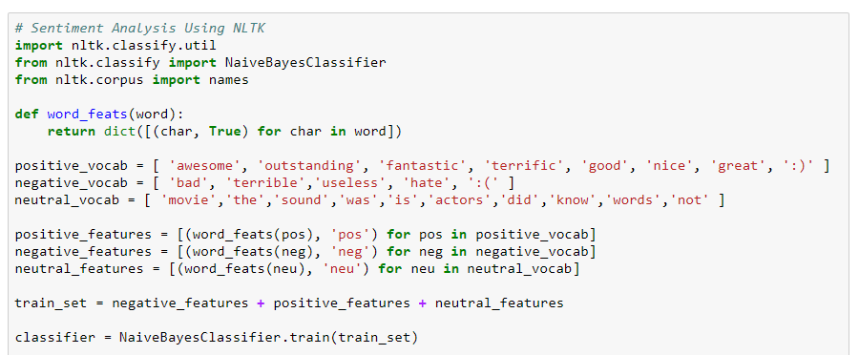
Sentiment Analysis (3)

Slide 44
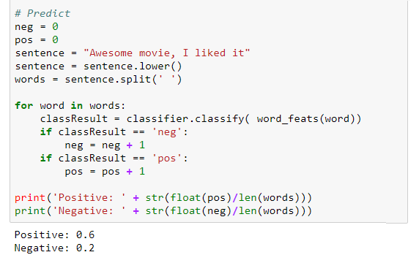
Sentiment Analysis (4)

Slide 45
Text Classification
Text classification is one of the classical problem of NLP.
Notorious examples include – Email Spam Identification, topic classification of news, sentiment classification and organization of web pages by search engines.
Text classification, in common words is defined as a technique to systematically classify a text object (document or sentence) in one of the fixed category.
It is really helpful when the amount of data is too large, especially for organizing, information filtering, and storage purposes.

Slide 46
Text Classification (2)
A typical natural language classifier consists of two parts: (a) Training (b) Prediction as shown in image on the next slide.
Firstly the text input is processes and features are created.
The machine learning models then learn these features and is used for predicting against the new text.

Slide 47
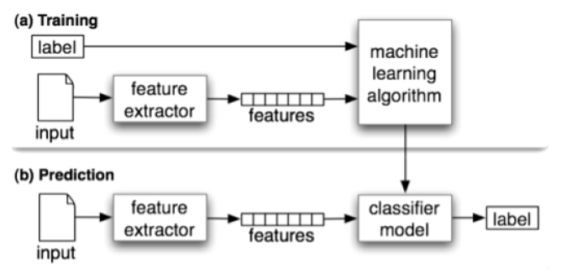
Text Classification (3)

Slide 48
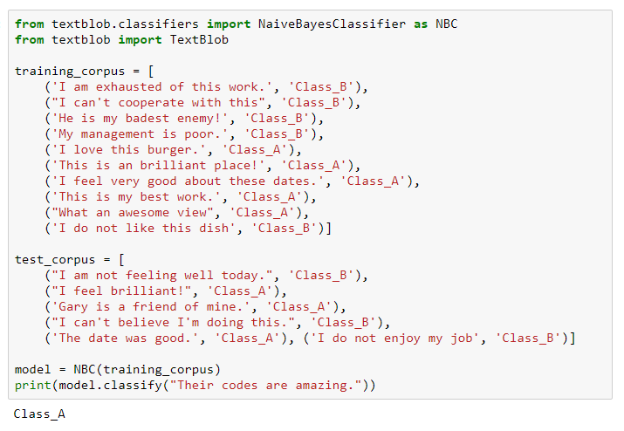
Text Classification (4)
Use TextBlob

Slide 49
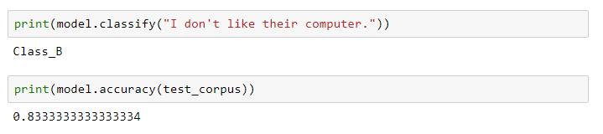
Text Classification (5)

Slide 50
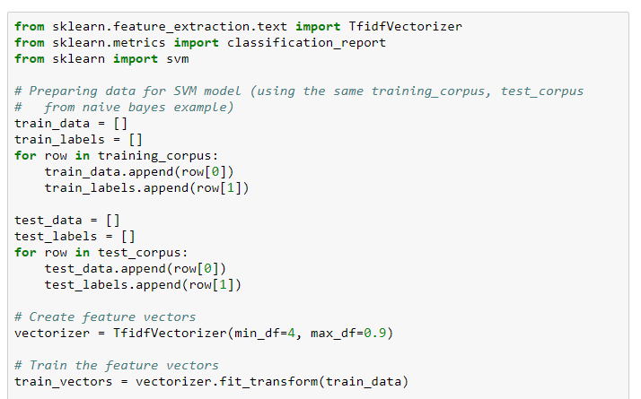
Text Classification (6)
Use Scikit-Learn

Slide 51
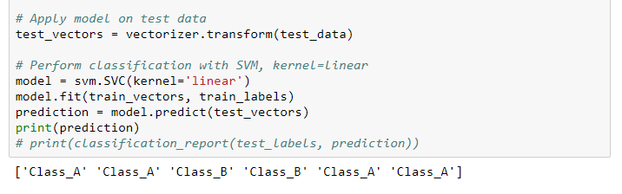
Text Classification (7)

Slide 52
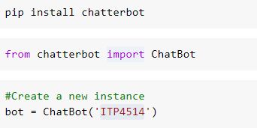
Chatbot
Creating a simple command-line chatbot using ChatterBot

Slide 53
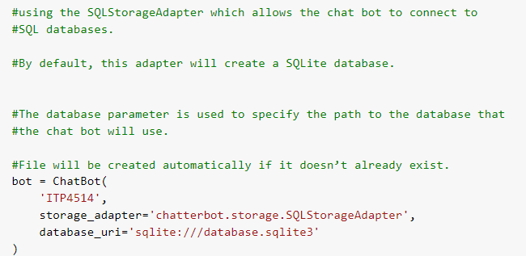
Chatbot (2)

Slide 54
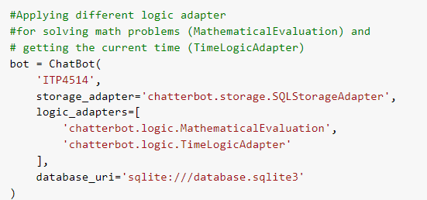
Chatbot (3)

Slide 55
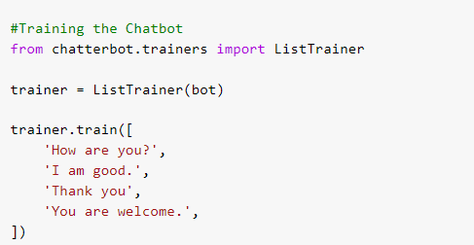
Chatbot (4)

Slide 56

Self Study Guide

Slide 57
Self Study Guide
References
Bird, S., Klein, E. & Loper, E. (2009). Natural Language Processing with Python (1st ed.). Sebastopol, CA: O’Reilly.
Bengfort, B., Bilbro, R. & Ojeda, T. (2018). Applied Text Analysis with Python: Enabling Language-Aware Data Products with Machine Learning (1st ed.). Sebastopol, CA: O’Reilly.
Sarkar, D. (2016). Text Analytics with Python: A Practical Real-World Approach to Gaining Actionable Insights from Your Data (1st ed.). New York, NY: Apress.

